Slide 1
Python Topics for Data Engineers
Focusing on Type Hints, Exceptions and Logging

Slide 2
Brief introduction to Python
Known for its readability, ease of use and diversity
Popular in data engineering, data science, and web development
Extensive standard library and active community
In Inspari we use Python in Databricks, Fabric, Data Science community
Azure Functions and small Ad Hoc tasks
Set-up:
Clone below REPOS and run ”main.py”
https://github.com/sorengod/Python-Pizza.git

Slide 3
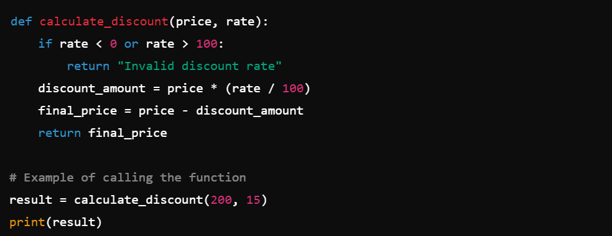
FUNCTIONS

Slide 4
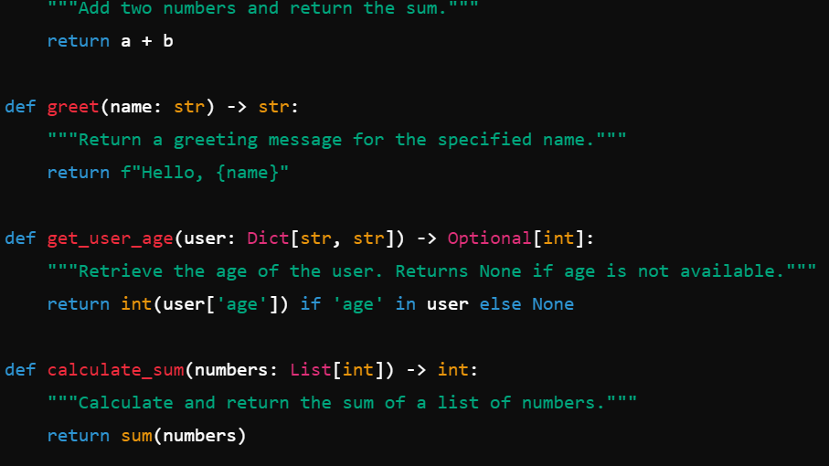
Type Hints and Description of Functions
Type hints are annotations that specify the expected types of variables, parameters, and return values within your code.
Descriptions are put in Doc-strings (’’’xxx’’’) and is a short description of the purpose of the function that enhances readability of the code.
Can also include a short description of the function return and function argument(s).

Slide 5
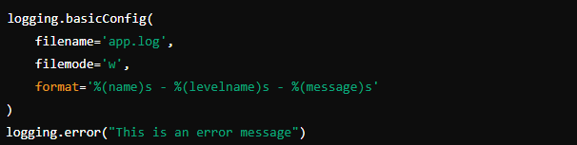
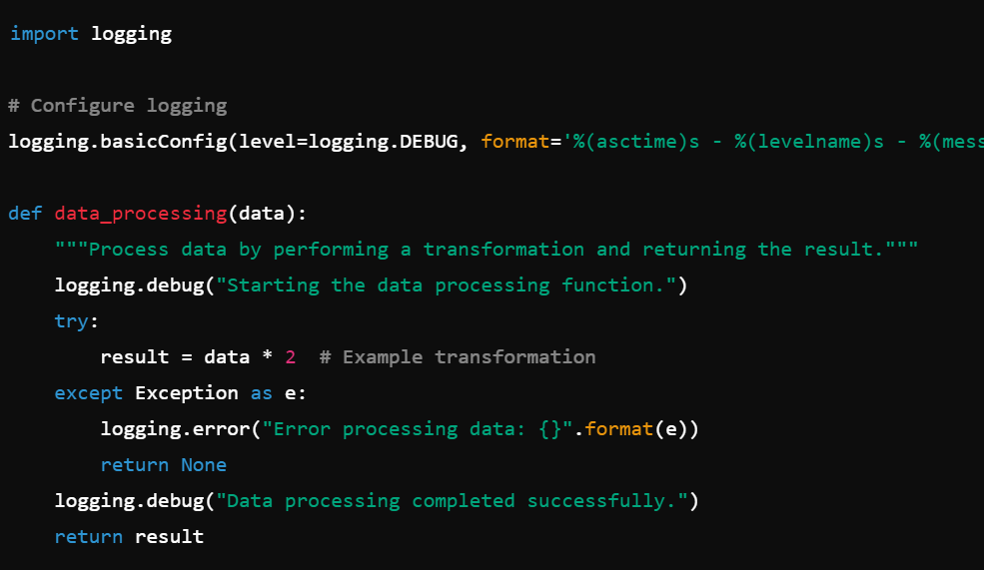
Basic Logging set-up
Logging is the process of recording information about the operational events of a program. It's more flexible and informative than simple print statements.
Setting up logging is straightforward with the ‘logging’ module which both support info, debug and error logging.
Logging can be altered to append to a file, overwrite to a file, specify dateformat, specify runtime, specify how errors are handled etc.

Slide 6
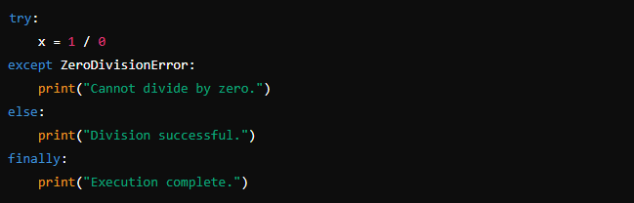
Understanding exceptions
Exceptions in Python are events that disrupt the normal flow of the program. They occur due to errors like dividing by zero, accessing a file that doesn't exist, or any other runtime error.
Handling exceptions effectively is crucial to building robust applications and ensuring the program can deal with unexpected situations gracefully.

Slide 7
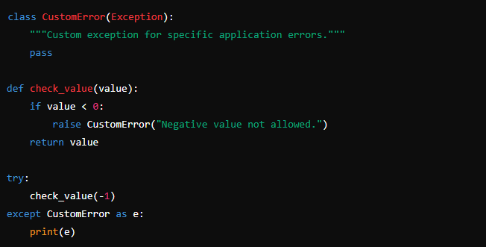
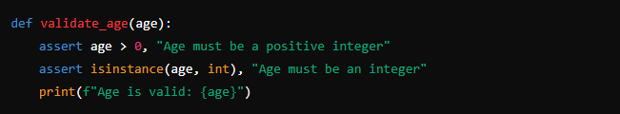
Custom Exceptions and AssertionErrors
Both exceptions and assertions help identify issues in the code and ensure it behaves as expected
Custom exceptions allow you to create specific error types for your application. This can make your code more readable
and easier to debug.
The ‘assert’ statement is used to set checkpoints in your code. If the
condition evaluated by ‘assert’ is false, an ‘AssertionError’ is raised
providing a message to help debug the issue.

